Slide 1


AI Verbatim Classification
PDT/AIDA/DAFE/DMST
FAB LAB ATC
2025
Notes:
Je suis ravi de vous retrouver aujourd’hui pour vous présenter les travaux menés par l'équipe Fablab ATC autour de la classification des verbatims.
Au cours des derniers mois, nous avons eu l’opportunité de contribuer à plusieurs projets ayant un objectif commun : mieux comprendre et structurer les retours clients en les classant par catégories et sous-catégories pertinentes. Cette démarche vise à enrichir l’analyse qualitative et à faciliter l’exploitation des données textuelles à grande échelle.
À travers cette présentation, je vais vous partager :

Slide 2
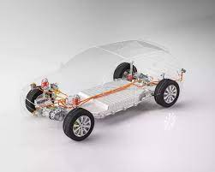
Focus on QFS PRS classification with LLM

Slide 3

PLAN
Context & Problem Statement
Classification Projects and Deliverables
Classification with ML Program
Classification with LLM (Large Language Model)
Results & Next Steps

Slide 4
Context & Problem Statement
The verbatims from QFS (Quality Feedback Survey) are manually analyzed and classified, with dependency on entity processing.
Identification of the real component impacted.
Complaints categorization by main problems.
More than 10 000 customer verbatims to classify .
Lot of categories and subcategories of vehicle function to identify.
New data every month.

Slide 5
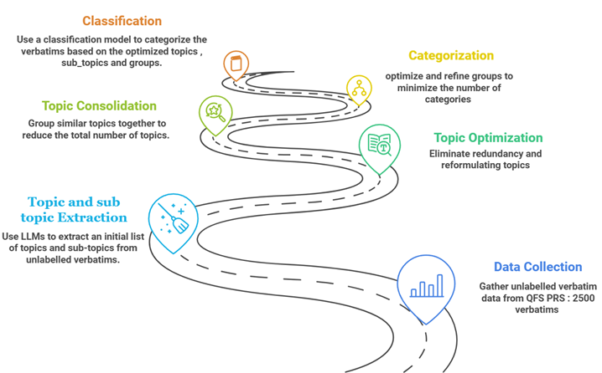






Context & Problem Statement
Classifying verbatims (text data) using AI involves categorizing text into predefined categories or classes automatically.
APPROACH:
Collect and clean customer survey responses for consistency.
Categorize feedback into relevant topics and categories.
Merge similar topics and eliminate duplicates.
Use generative AI to match feedback to the most relevant topics based on context.
Continuously update the topic list and create new topics as new feedback is processed.
CHALLENGES
Noisy and redundant data.
Topic granularity.
Scalability and data evolution.
Tools :
ADDED VALUE
Time-saving & automation
More accurate & relevant classification
Improved customer satisfaction
Better decision-making

Slide 6
Smart Approach to Verbatim Classification
📌 Problem Statement
2,500 verbatims to classify
Goal: Organize them into ~300 topics, ~124 subcategories,
and 12 main categories
Challenge: Insufficient labeled data
📌 Limitations of Traditional Machine Learning
❌ Lack of labeled data
A supervised ML model requires a large volume of labeled data for accuracy
Manual labeling is costly and time-consuming
An undertrained ML model would result in low accuracy and biased classification
📌 Why Choose a LLM (Large Language Model)?
✅ Advanced contextual understanding
LLMs can generalize classification thanks to their deep language comprehension
They can identify patterns without requiring large amounts of labeled data
✅ Flexibility & Scalability
Can adapt to new verbatims without retraining from scratch
Enables deeper insights with finer classification granularity
🎯 Conclusion: LLM as a Strategic Choice → Due to the lack of labeled data, LLMs provide a more robust and effective solution compared to traditional ML approaches.

Slide 7

Scope definition
📌Topics , Subcategories and categories generation
With LLM(DBRX)
TOPICS
With LLM(DBRX)
subCategories
FAISS Indexation + Similarité Cosinus
Group
Cleaning
topics
Sub Category
Category or group
Verbatims
VERBATIMS List
(2500 verbatims)
Group
…
List of GROUP
LLM (DBRX)
Groups of Subcategories
Fusion des groupes similaires using
Similarité Cosinus
Notes:
e

Slide 8

Main steps
📌 Step 1 : defined the list of topics , Subcategories and categories
VERBATIMS List
(2500 verbatims)
With LLM(DBRX)
Topics , Sub.cat., Cat.
Defined List
Cleaning
Reduction of the topics list
topics
Sub Category
Category or group
Verbatims
…
📌 Step 2 : Strategy for classification
Defined List
Best similiraty score
or
LLM
Classification
Classified Verbatims
Matched Topics List
(similarty score + similarity threshold)
New Verbatims List
Notes:
e

Slide 9

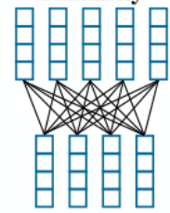
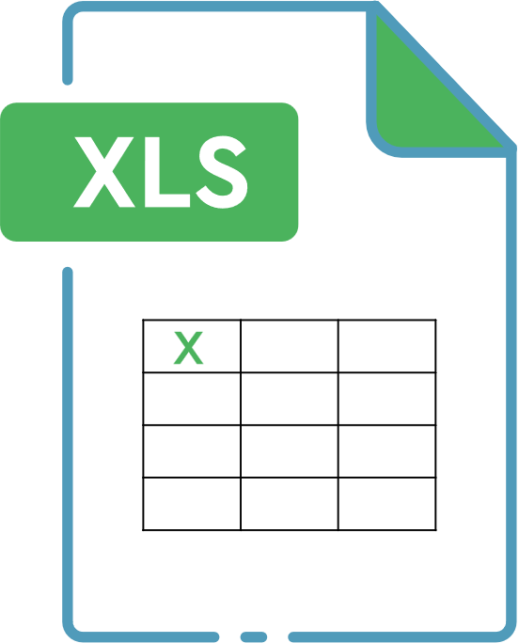
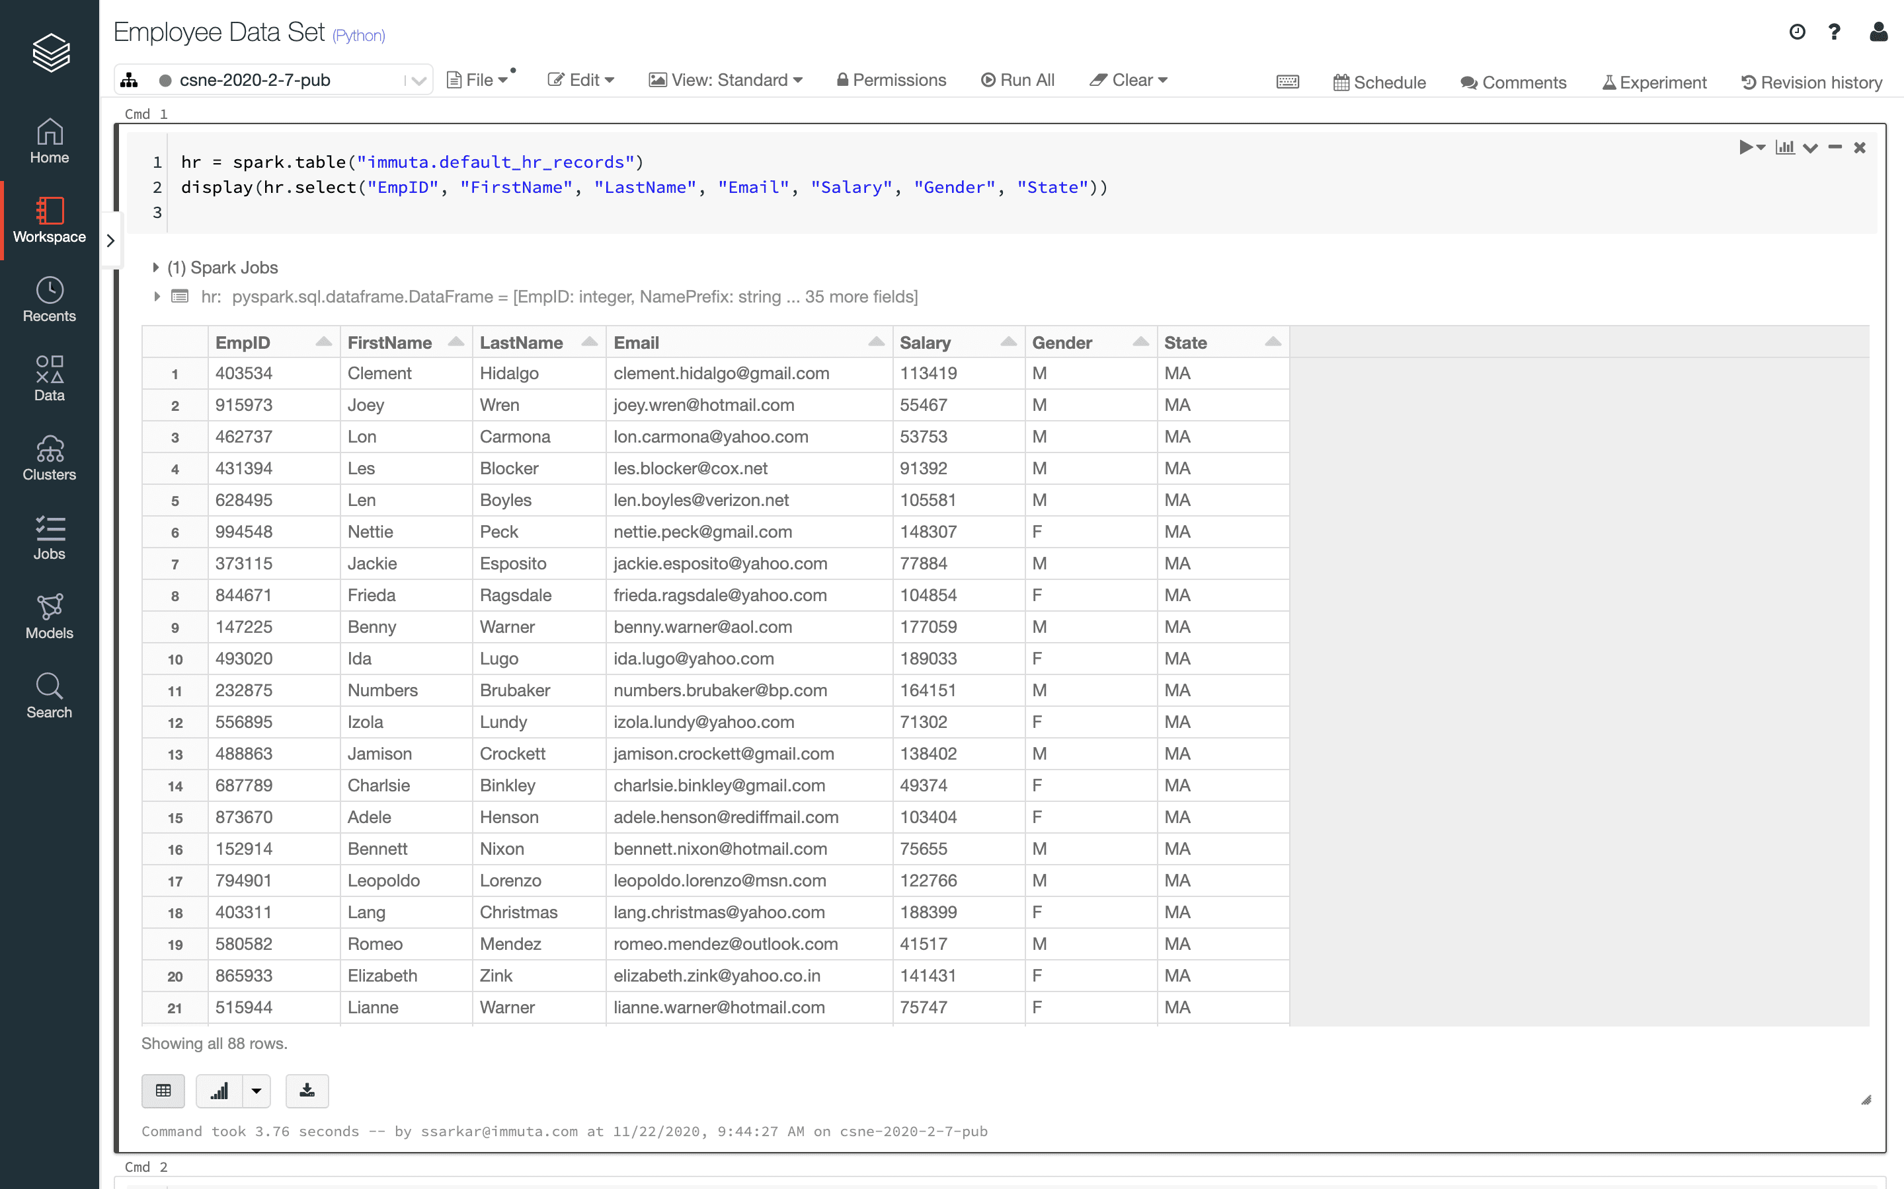

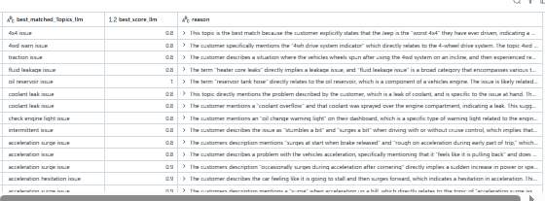
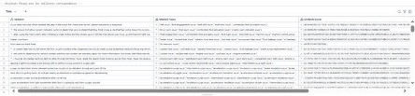
Global WORKFLOW
Collection & Preprocessing
Topic Generation via LLMs (DBRX model)
Post-processing
Cleaning
Prompt Engineering
LLMS (DBRX)
Tokenization
Optimization
NER tagging
Extract data from customer surveys
Instructions
Categorized topics:
960 Topics
124SubCategory
12 Category
POS tagging
2344 Verbatims
765 Topics
124SubCategory
12 Category
Lemmatisation
Context
Update list of Topics
2500 Verbatims
Pre-trained on billions of parametres
Cleaned Verbatims
Cleaned Topics
StopwordsRemoval
Standardization
Verbatims
SubCategory
Category
Matching hybrid Method (BERT Similarity + Llama LLM)
Similarity-Based Matching (Roberta Embedding & Similarity Calculation)
155 Irrelevant Verbatims Removed)
LLM-Based Selection (Llama 3)
Matched Topics with LLama
Tokenize Cleaned Topics and Verbatims & create BERT embeddings
Verbatims with corresponding topics
Prompt Engineering
Generate similarity scores using cosine similarity
save the best-matched topics Lists into an Excel file
Ouputs: Best Topic
Reason for Best Selection
LLM lLama3
Define thresholds
[0.3,..0.9]
Clacul Statistical Metrics:
(Mean,STD,Count)
for each thresholds
Select optimal threshold
(Mean + 2 * Std Dev)
Min. threshold
Match topics list
Notes:
Vector embeddings : « all mini » = modèle pré-entraîné dérivé de BERT / on going with ROBERTA (évolution de BERT)

Slide 10
Global WORKFLOW
Collection & Preprocessing
Data Preprocessing (Cleaning the Verbatim)
Objective: Normalize and clean Verbatim data for Processing
🔧 Techniques Used :
1. Regular Expressions
Remove unwanted symbols or characters (extra punctuation, special characters)
🔄 Contractions Expansion:
Expand contracted forms to their full versions to improve uniformity
⚙ Lowercasing
Convert all text to lowercase to avoid case-sensitive inconsistencies during processing.
Whitespace Normalization
Remove extra spaces and ensure consistent spacing between words.
Extract data from customer surveys
2500 Verbatims
StopwordsRemoval
Standardization
155 Irrelevant Verbatims Removed)
Original: There were a few times when it seemed that shifts were rougher than normal... don’t know if the control software...
Output: there were a few times when it seemed that shifts were rougher than normal do not know if the control software
Notes:
Vector embeddings : « all mini » = modèle pré-entraîné dérivé de BERT / on going with ROBERTA (évolution de BERT)

Slide 11
Global WORKFLOW
Topic Generation via LLMs (DBRX model)
Post-processing
Cleaning
Prompt Engineering
LLMS (DBRX)
Tokenization
Optimization
NER tagging
Instructions
Categorized topics:
902 Topics
124SubCategory
12 Category
POS tagging
2344 Verbatims
765 Topics
124SubCategory
12 Category
Lemmatisation
Context
Pre-trained on billions of parametres
Cleaned Verbatims
Cleaned Topics
Verbatims
SubCategory
Category
Post-Processing Steps
🔧 Post-Processing Steps
🔹 Duplicate Removal
🔹 Special Character Cleanup
🔹 Term Normalization
🔹 POS and NER Tagging
🔹 Topic Standardization
.
🔧 Prompt Configuration Details
🔹 Model Used: DBRX 🔹 Prompt Type: Instruction-based + Few-shot examples
🔹 Prompt Structure:
🔹Context Setup
🔹 Explicit Instructions
🔹 Few-shot Examples:
Includes 3 example verbatims with expected structured outputs
Helps the model learn the format and improve consistency
Topic Original | 🔧 Étapes Appliquées | ✅ Topic Final Unifié
Gear shifting\irregularities | Nettoyage caractère spécial (\\), lemmatisation | Gear shifting irregularity issue
Gear shifting irregularity | Lemmatisation, normalisation | Gear shifting irregularity issue
Gear shifting issues | Synonym unification (issues, problems, malfunction) | Gear shifting issue
Gear shifting jerk | Lemmatization, structure unifiée | Gear shifting jerk issue
Gear shifting jerks | Pluriel → singulier, synonym match | Gear shifting jerk issue
Gear shifting jolt | Structure standardisée | Gear shifting jolt issue
Gear shifting jolts | Lemmatization | Gear shifting jolt issue
Gear shifting lurch | Ajout de sous-type standardisé | Gear shifting lurch issue
Gear shifting malfunction | Synonym standardisation (malfunction → issue) | Gear shifting issue
Gear shifting malfunctions | Pluriel → singulier, lemmatisation | Gear shifting issue
Gear shifting noises | Lemmatization, précision ajoutée | Gear shifting noise issue
Gear shifting problems | Synonym match avec "issues" | Gear shifting issue
Notes:
Vector embeddings : « all mini » = modèle pré-entraîné dérivé de BERT / on going with ROBERTA (évolution de BERT)

Slide 12
Global WORKFLOW
🔁 Hybrid Semi-Supervised Pipeline
🔹 Semantic Vectorization
Model: RoBERTa via sentence-transformers
Task: Generate vector embeddings for cleaned verbatims and topics
📏 Similarity-Based Matching
Metric: Cosine Similarity
Use of the formula: quality_score=mean_similarity+2×std_similarity
📏
2344 Verbatims
765 Topics
124SubCategory
12 Category
LLM-Based Refinement
Model: LLaMA
Prompt Engineering (Structure):
Input: Verbatim + List of topics (above threshold)
Task: Select the most contextually appropriate topic
Output: Final topic + explanation of the choice based on verbatim semantics
Update list of Topics
Cleaned Topics
SubCategory
Category
Verbatims
🔄 Continuous Improvement Loop
Tasks:
.Unmatched verbatims (below threshold) are re-sent to DBRX to generate new topics
.The cleaned topic base is continuously enriched and updated
Matching Method (BERT Similarity + Llama LLM)
Topic Selection
LLM-Based Selection (Llama 3)
Similarity-Based Matching (Roberta Embedding & Similarity Calculation)
Tokenize Cleaned Topics and Verbatims & create BERT embeddings
Matched Topics with LLama
Verbatims with corresponding topics
save the best-matched topics Lists into an Excel file
Prompt Engineering
Ouputs: Best Topic
Reason for Best Selection
Generate similarity scores using cosine similarity
LLM lLama3
Define thresholds
[0.3,..0.9]
Clacul Statistical Metrics:
(Mean,STD,Count)
for each thresholds
Select optimal threshold
(Mean + 2 * Std Dev)
Min. threshold
Match topics list
Notes:
Vector embeddings : « all mini » = modèle pré-entraîné dérivé de BERT / on going with ROBERTA (évolution de BERT)

Slide 13
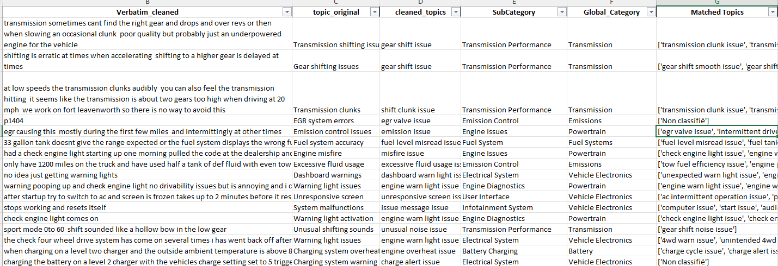
Result

Slide 14
What’s Next?
Initial results are now available ✅
We are currently in the evaluation phase 🔍
Testing on new verbatims to assess classification accuracy.
Adjusting parameters, including the similarity threshold, to optimize performance.
The goal is to refine the model for better precision and reliability before final deployment.
📌 Next Actions: 🔹 Validate results with other new data 🔹 Improve classification consistency if necessary

Slide 15
IA Verbatim Classification
PDT/AIDA/DAFE/DMST
Thank you
FAB LAB ATC
2025

